Slide 1
Virtual digital signal processing using LabVIEW
for signal processing applications like ac susceptibility measurements
Project Report
R K Rupesh

Slide 2
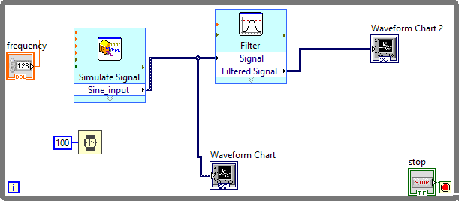
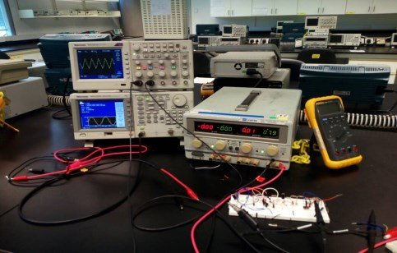
Virtual instrumentation
Virtual instruments are a fundamental shift from traditional hardware-centered instrumentation
Environmental Noise-free Processing
software-centered systems exploit computing power and connectivity capabilities of PC
e.g. Virtual world during Covid-19 !!!

Slide 3

Noises
There’s noise in every measurement!
Real world Images
DISCRIMINATOR
TRUE
Noise Generator
FALSE

Slide 4
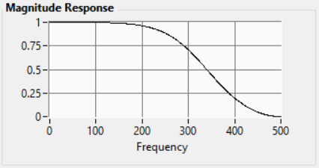
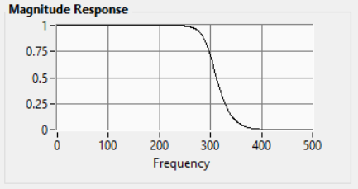
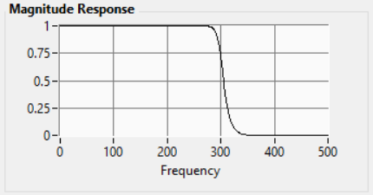
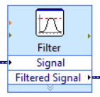
Digital Filters
a) Order 2
b) Order 8
c) Order 13
Digital filters produce almost zero noise
Digital filters are highly customizable
They have a steep frequency response

Slide 5
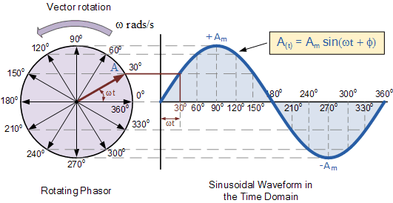
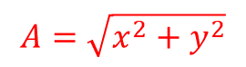
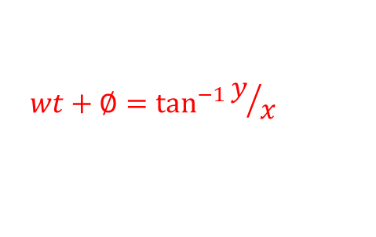
Phasor diagram
$$A=\sqrt{x^{2}+y^{2}}$$
$$wt+∅=\tan^{−1}{y/x}$$

Slide 6
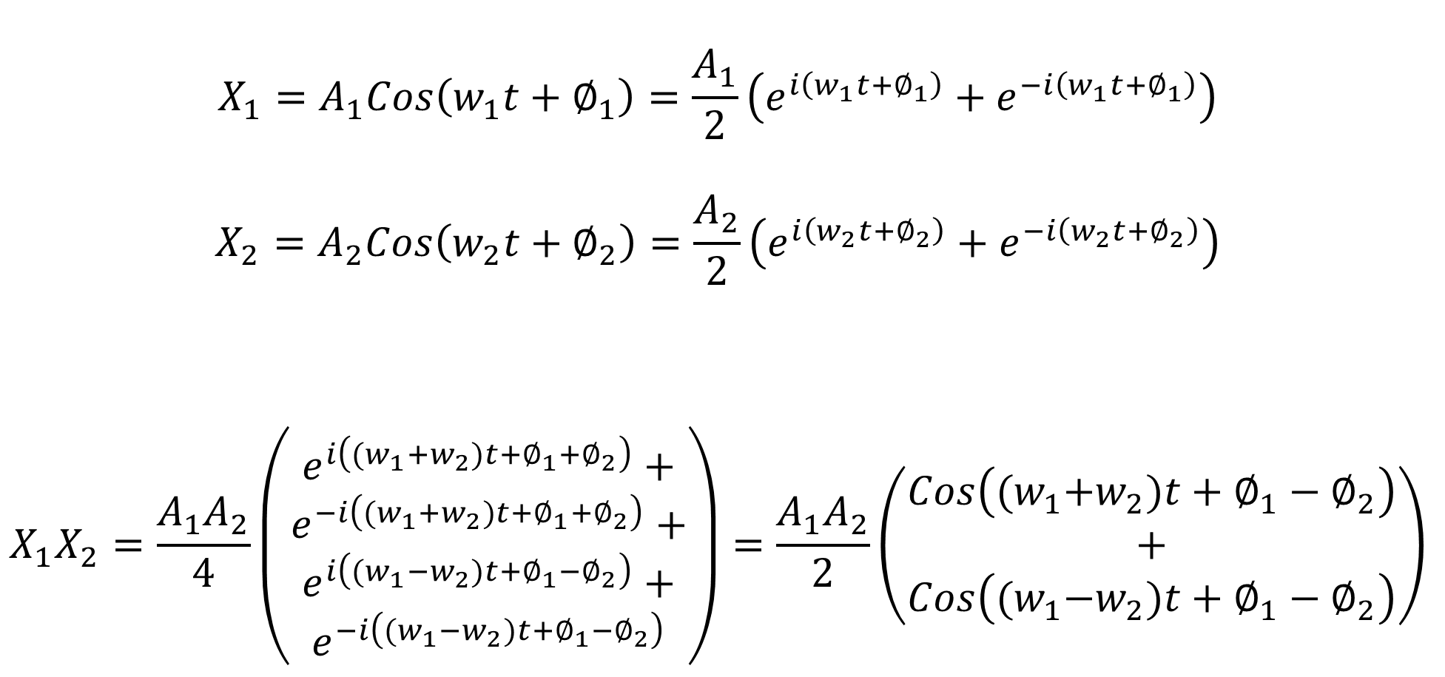
Signal Mixing
$$X_{1}=A_{1}Cos\left(w_{1}t+∅_{1}\right)=\frac{A_{1}}{2}\left(e^{i\left(w_{1}t+∅_{1}\right)}+e^{−i\left(w_{1}t+∅_{1}\right)}\right)$$
$$X_{2}=A_{2}Cos\left(w_{2}t+∅_{2}\right)=\frac{A_{2}}{2}\left(e^{i\left(w_{2}t+∅_{2}\right)}+e^{−i\left(w_{2}t+∅_{2}\right)}\right)$$
$$X_{1}X_{2}=\frac{A_{1}A_{2}}{4}\left(\begin{aligned}e^{i\left({(w}_{1}{+w}_{2})t+∅_{1}+∅_{2}\right)}+ \\ \begin{aligned}e^{−i\left({(w}_{1}{+w}_{2})t+∅_{1}+∅_{2}\right)}+ \\ \begin{aligned}e^{i\left({(w}_{1}{−w}_{2})t+∅_{1}−∅_{2}\right)}+ \\ e^{−i\left({(w}_{1}{−w}_{2})t+∅_{1}−∅_{2}\right)}\end{aligned}\end{aligned}\end{aligned}\right)=\frac{A_{1}A_{2}}{2}\left(\begin{aligned}Cos\left({(w}_{1}+w_{2})t+∅_{1}−∅_{2}\right) \\ + \\ Cos\left({(w}_{1}−w_{2})t+∅_{1}−∅_{2}\right)\end{aligned}\right)$$

Slide 7
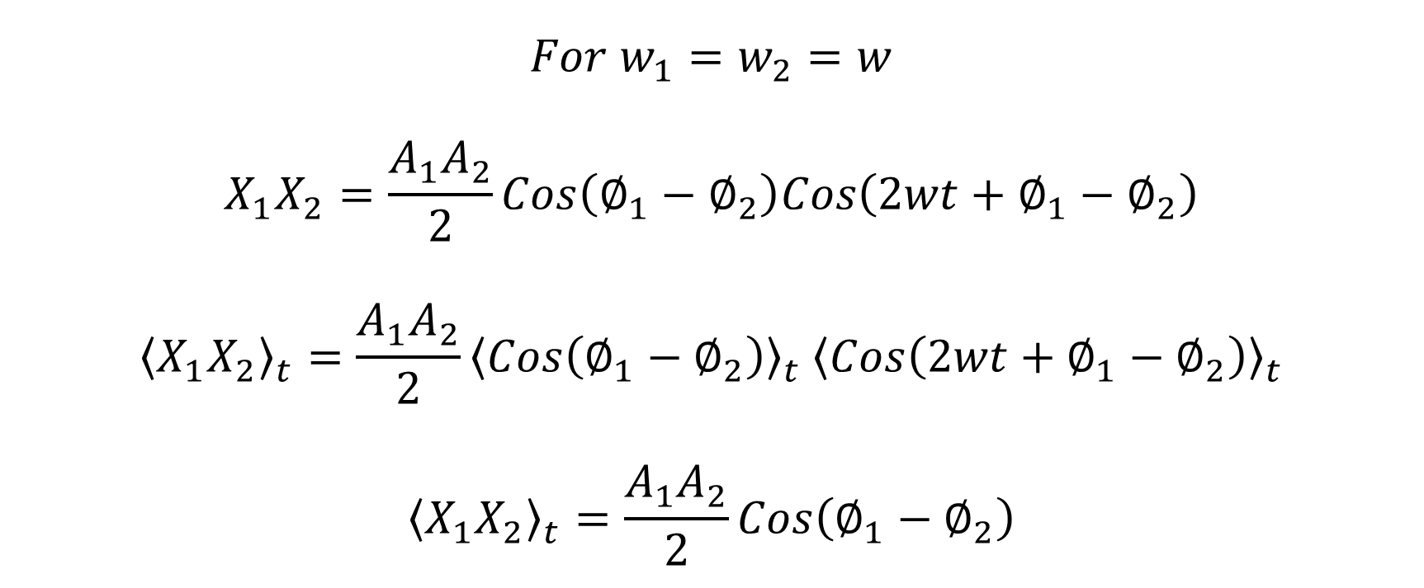
Signal Mixing
$$For{ w}_{1}=w_{2}=w$$
$$X_{1}X_{2}=\frac{A_{1}A_{2}}{2}Cos\left(∅_{1}−∅_{2}\right)Cos\left(2wt+∅_{1}−∅_{2}\right)$$
$${\left\langle X_{1}X_{2}\right\rangle }_{t}=\frac{A_{1}A_{2}}{2}{\left\langle Cos\left(∅_{1}−∅_{2}\right)\right\rangle }_{t} {\left\langle Cos\left(2wt+∅_{1}−∅_{2}\right)\right\rangle }_{t}$$
$${\left\langle X_{1}X_{2}\right\rangle }_{t}=\frac{A_{1}A_{2}}{2}Cos\left(∅_{1}−∅_{2}\right)$$

Slide 8
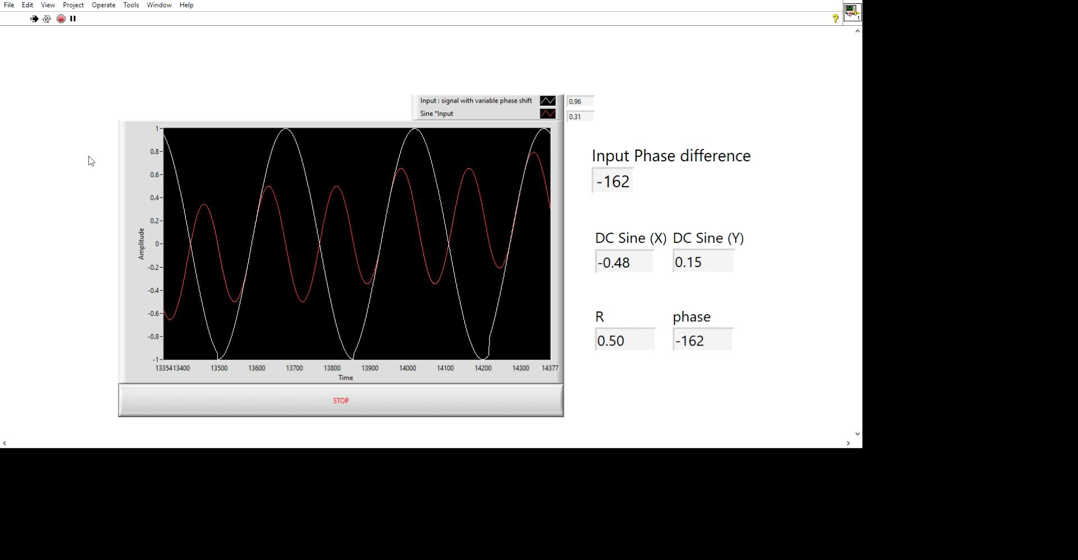
Extracting Phase and Amplitude information
Changing Input Phase
Phase Information extracted by signal Mixing and demodulating

Slide 9
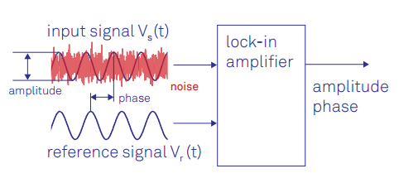
Lock-in Amplifier – An Advanced filter
Lock-in amplifiers are capable of measuring the amplitude and the phase of a signal relative to a defined reference signal, even if the signal is buried in noise

Slide 10
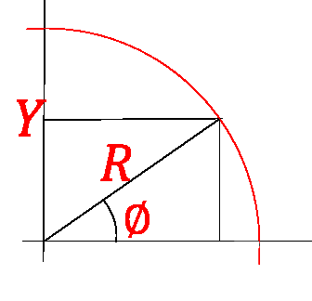
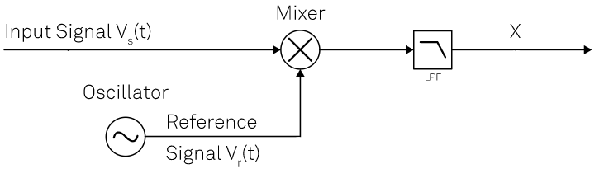



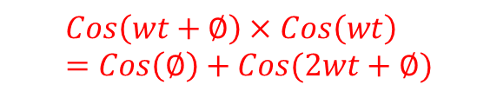

Principle of Phase Sensitive Detection
$$Cos\left(wt+∅\right)×Cos\left(wt\right)=Cos\left(∅\right)+Cos(2wt+∅)$$
$$Cos⁡(wt+∅)$$
$$Cos⁡(∅)$$
$$X$$
$$Cos⁡(wt)$$
The Real Part

Slide 11
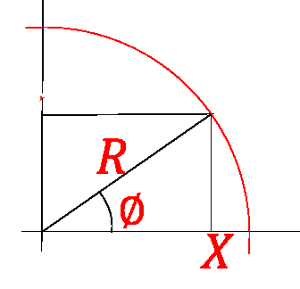


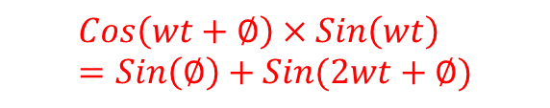
Principle of Phase Sensitive Detection
Y
$$Cos\left(wt+∅\right)×Sin\left(wt\right)=Sin\left(∅\right)+Sin(2wt+∅)$$
$$Sin(∅)$$
$$Cos⁡(wt+∅)$$
Y
$$Sin⁡(wt)$$
The Quadrature Part

Slide 12
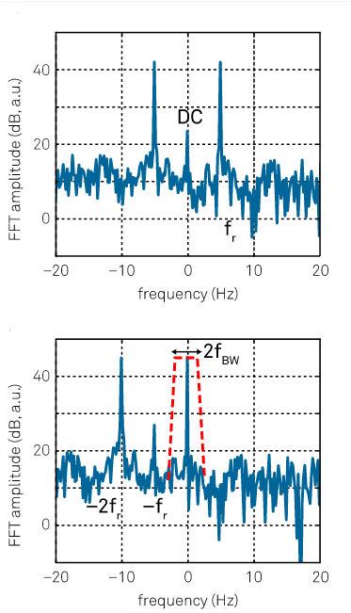
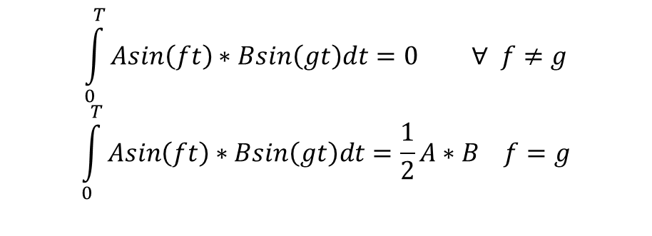
The frequency domain and Fourier transform
The Fourier transform converts a sinusoidal function with frequency f₀ in the time domain into a Dirac delta function δ(f-f₀) in the frequency domain
$$\int_{0}^{T}{Asin\left(ft\right)∗Bsin\left(gt\right)dt=0 ∀ f≠g}$$
$$\int_{0}^{T}{Asin\left(ft\right)∗Bsin\left(gt\right)dt=\frac{1}{2}A∗B f=g}$$

Slide 13
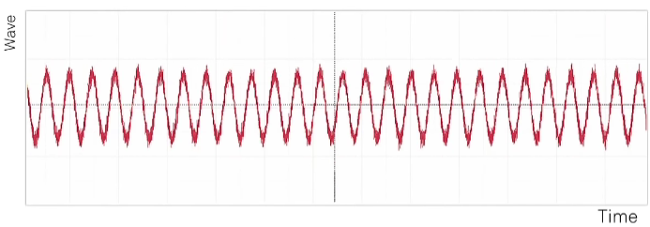
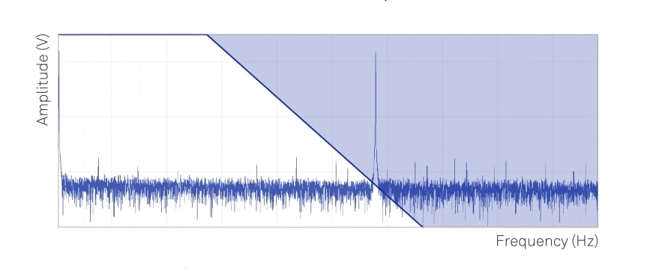
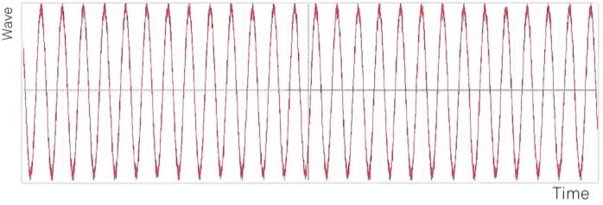
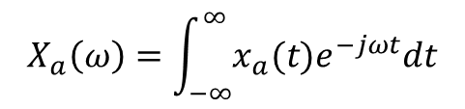
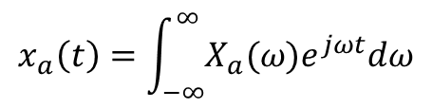
Filtering
$$X_{a}\left(ω\right)=\int_{−∞}^{∞}{x_{a}(t)e^{−jωt}dt}$$
$$x_{a}\left(t\right)=\int_{−∞}^{∞}{X_{a}(ω)e^{jωt}dω}$$

Slide 14
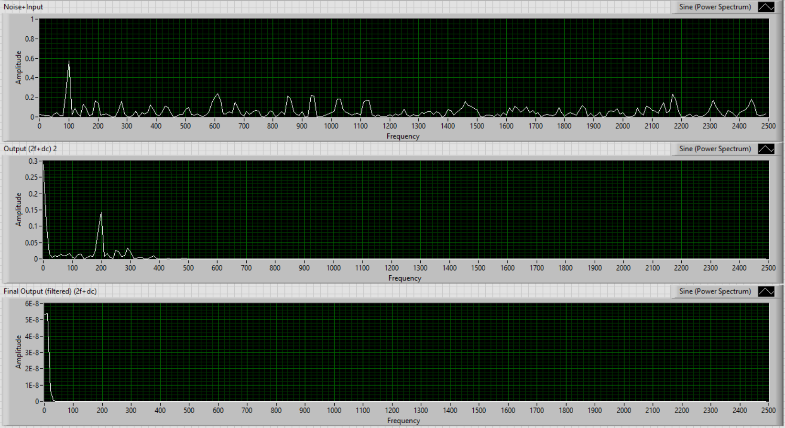
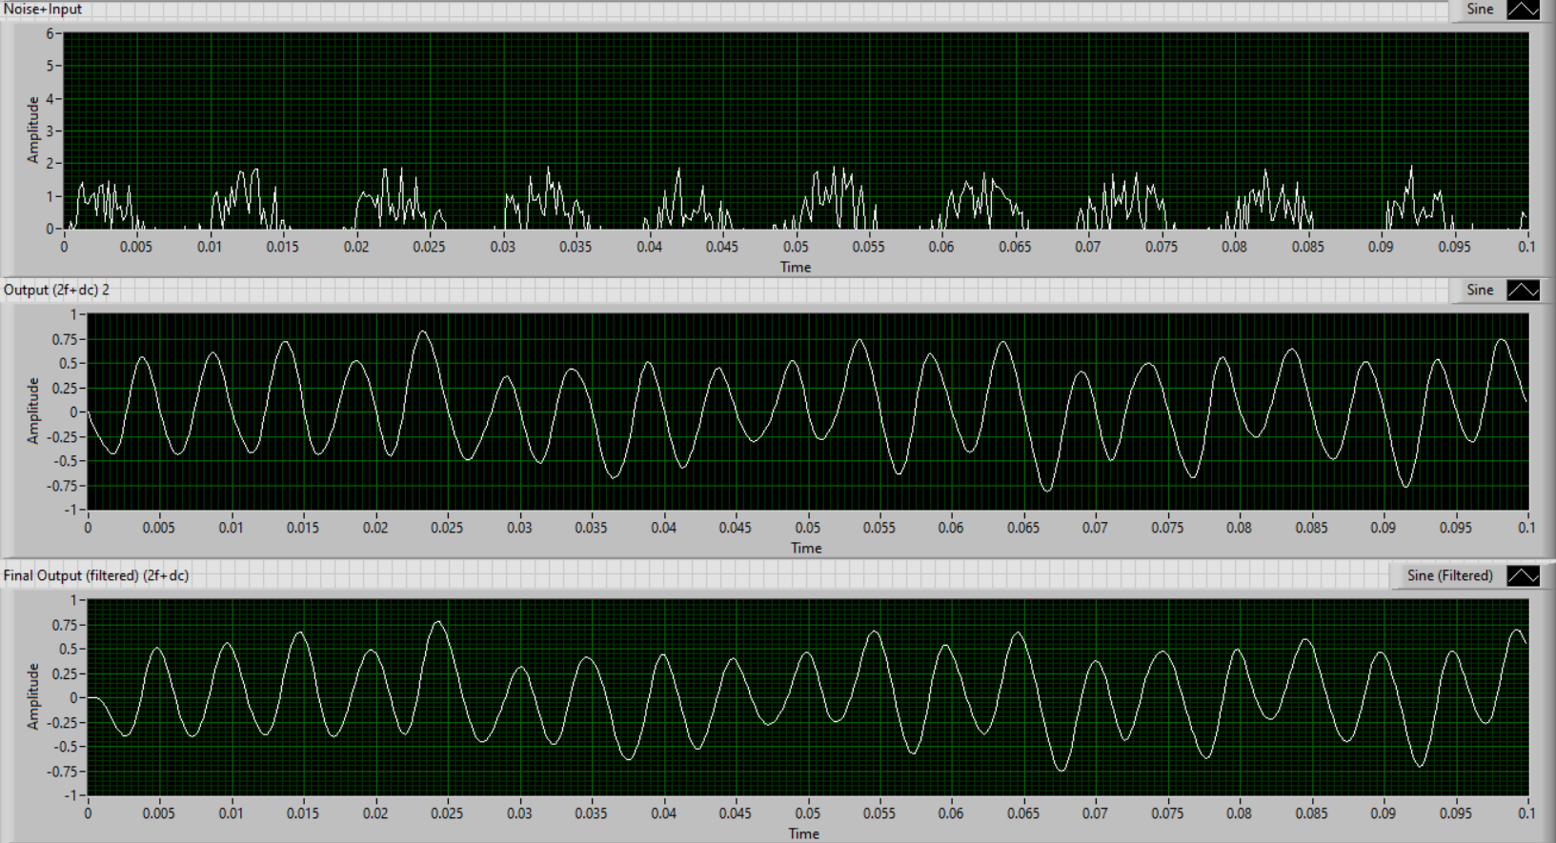

100Hz signal with noise
Signal
DC
$$2∗w$$
DC

Slide 15
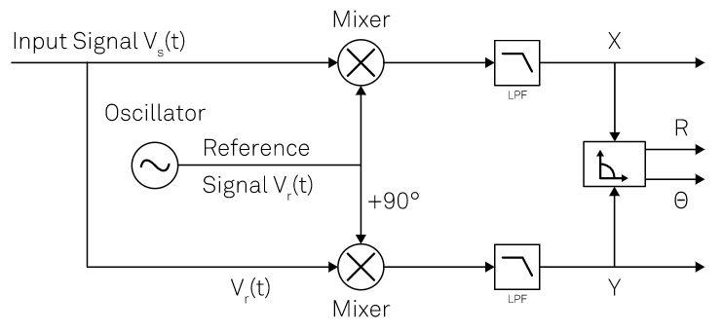
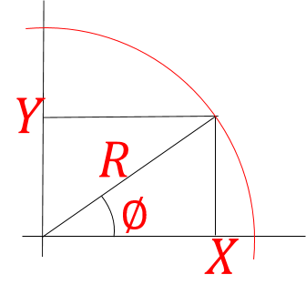
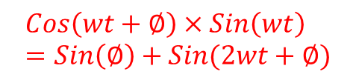
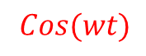
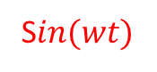

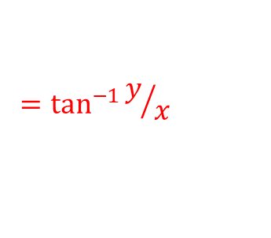
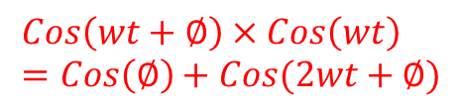
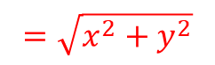


Principle of Dual Phase Lock-in Amplifier
$$Cos\left(wt+∅\right)×Cos\left(wt\right)=Cos\left(∅\right)+Cos(2wt+∅)$$
$$Cos⁡(wt+∅)$$
$$Cos(∅)$$
$$=\sqrt{x^{2}+y^{2}}$$
$$Cos⁡(wt)$$
S$in⁡(wt)$
$$=\tan^{−1}{y/x}$$
$$Sin⁡(∅)$$
$$Cos\left(wt+∅\right)×Sin\left(wt\right)=Sin\left(∅\right)+Sin(2wt+∅)$$

Slide 16
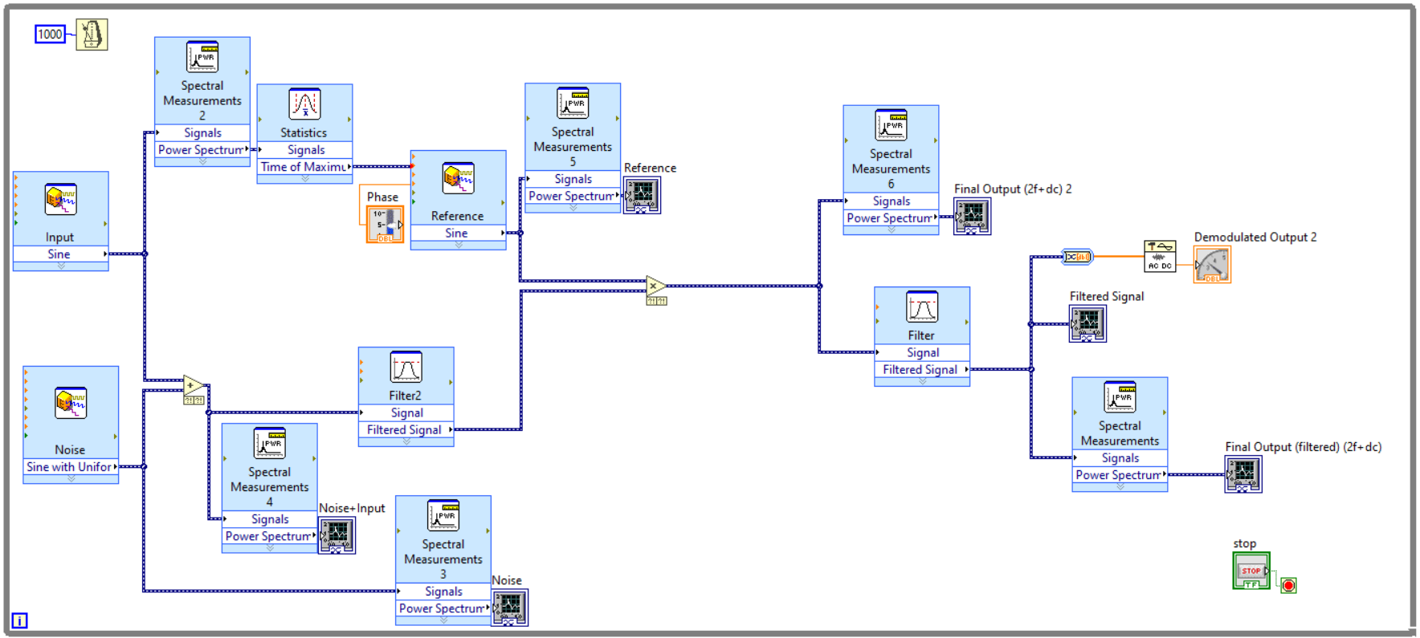

A Digital Lock-in Amplifier
$$DC$$

Slide 17
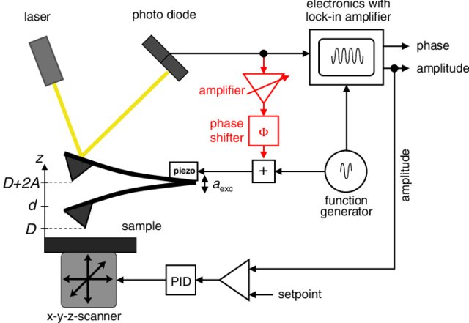
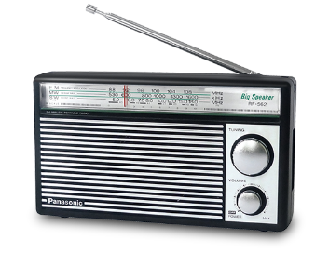

Application of Advanced filters can be found in many fields in every day Technology, Physics and Research
Radio and telecommunication
Atomic Force Microscope

Slide 18
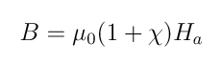
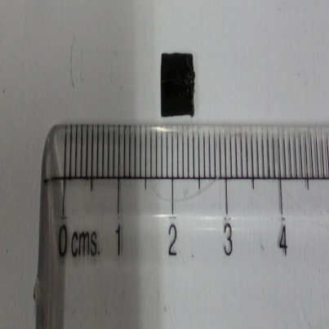
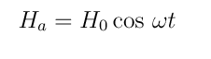
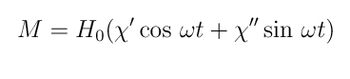
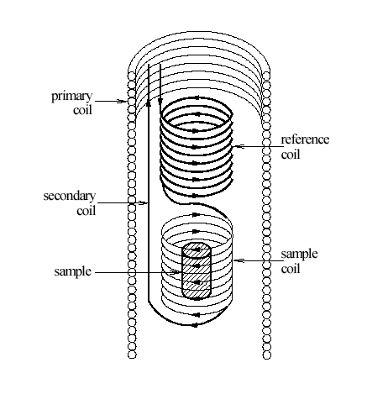
Case Study: AC Susceptometer
AC Susceptometer is used to measure changes in magnetic field due to the presence of a magnetic sample
Sample and T-sensor

Slide 19
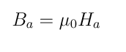
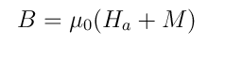
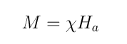
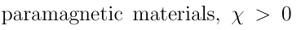
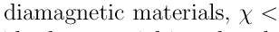

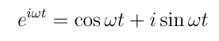

The Theory of AC Susceptometer
For some materials, x’’ is nearly zero. If x’’=0, the magnetization will be perfectly in phase with Ha for a paramagnetic material (X’ > 0) and will be 180deg out of phase for a diamagnetic material]

Slide 20
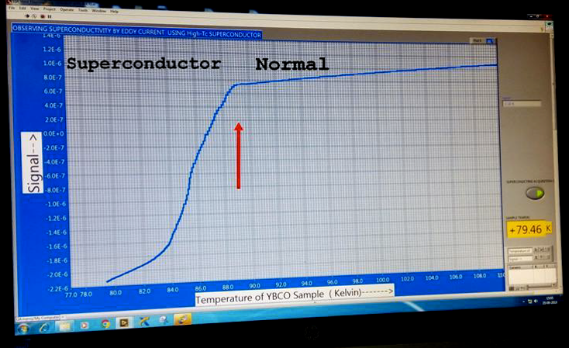
Magnetic Phase Transition of YBCO

Slide 21
Tasks Achieved
Learning LabVIEW programming
Simulating a sine wave in LabVIEW
Designing a program for observing signal mixing
Mathematics of signal mixing
Extracting phase information from signal mixing
Mathematics of different filters
Simulating a low-pass filter in LabVIEW and generating a bode plot
Mathematics of lock-in amplifiers
Case study of AC susceptometer as an application

